Slide 1
What is RFID?
Radio Frequency Identification (RFID) is the Wireless non-contact use of radio-frequency electromagnetic fields to transfer data for the purpose of automatically identifying and tracking tags attached to assets
ADC [Automated Data Collection]

Slide 2
RFID
RFID, or Radio Frequency Identification, is a system for transferring data over short distances (typically less than 6 inches).
Often only one of the two devices needs to be powered, while the other is a passive device.
This allows for easy use in such things as credit cards, key fobs, and pet collars as there is no need to worry about battery life.
The downside is that the reader and the information holder (i.e credit card) must be very close, and can only hold small amounts of data

Slide 3
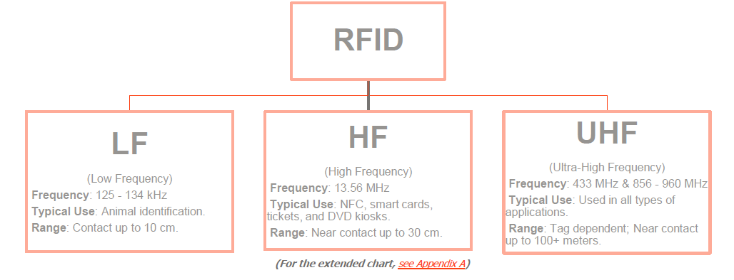
RFID

Slide 4
Identification
Assign IDs to objects
Link the ID to additional information about the object

Slide 5
Identification Examples
Bar Codes
License Plates
Social Security Numbers
Student ID
Serial Numbers
Database Key

Slide 6
RFID System
Tag Reader - Transceiver
RFID tag - Transponder
Antenna [Media interface Layer]

Slide 7
RFID Hardware
Magnetic / Inductive Coupling
IC or microprocessor
Transceiver
Tag Reader
RFID
Tag
antenna
antenna
Notes:
When the tag is placed close enough to the reader the field from the reader coil will couple to the coil from the tag. A voltage will be induced in the tag that will be rectified and used to power the tag circuitry.

Slide 8
RFID Hardware
Propagation Coupling
IC or microprocessor
Transceiver
Tag Reader
RFID
Tag
antenna
antenna

Slide 9
Tags
A Tag is a transponder which receives a radio signal and in response to it sends out a radio signal.
Tag contains an antenna, and a small chip that stores a small amount of data
Tag can be programmed at manufacture or on installation
Tag is powered by the high power electromagnetic field generated by the antennas
The field allows the chip/antenna to reflect back an extremely weak signal containing the data
Notes:
Two components-

Slide 10
Types of Tags
Passive Tags
No battery
Low cost
Active Tags
On-board transceiver
Battery – must be replaced
Longer range
High cost

Slide 11
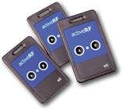
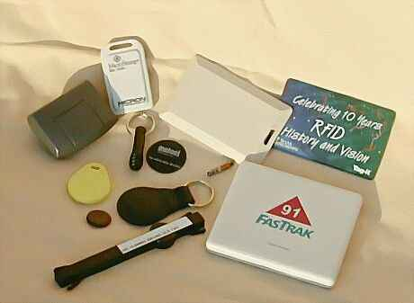
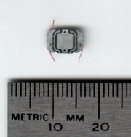
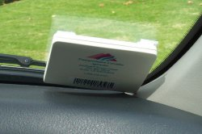
Different types of tags

Slide 12
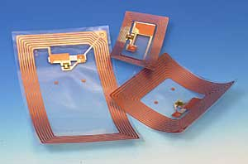
Real Tags

Slide 13
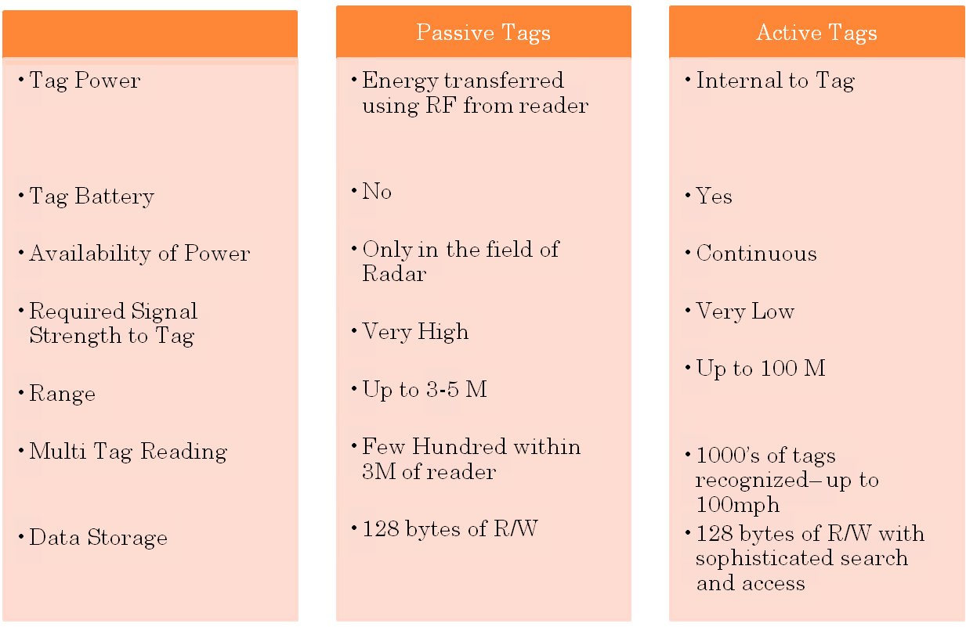
TAG ATTRIBUTES

Slide 14
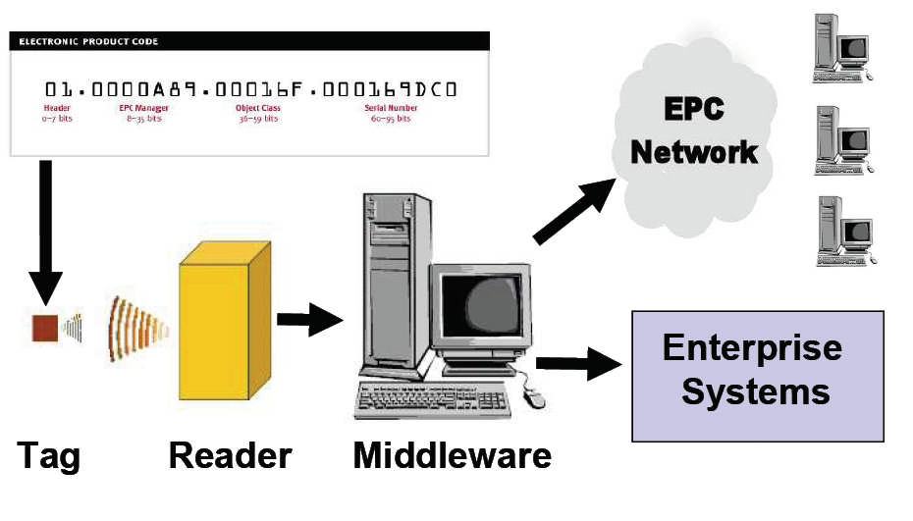
RADIO FREQUENCY IDENTIFICATION (RFID)

Slide 15
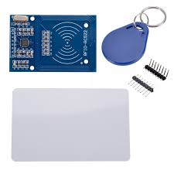
RFID READER/WRITER (RC522)

Slide 16
MIFARE CARD
Understanding the memory structure of MIFARE Classic cards
The MIFARE Classic card is a memory storage device. The memory is divided into sectors, which are also divided into blocks of 16 bytes.
The MIFARE Classic 1K card has 16 sectors, each of which are divided into four blocks. If we do the math, we can figure out how the memory structure would be like: 16 bytes (1 block) * 4 blocks * 16 sectors = 1024 bytes.
The card reader and the tags communicate using a 13.56MHz

Slide 17
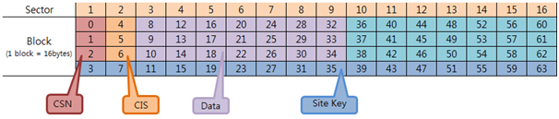
MIFARE 1K CARD MEMORY STRUCTURE

Slide 18
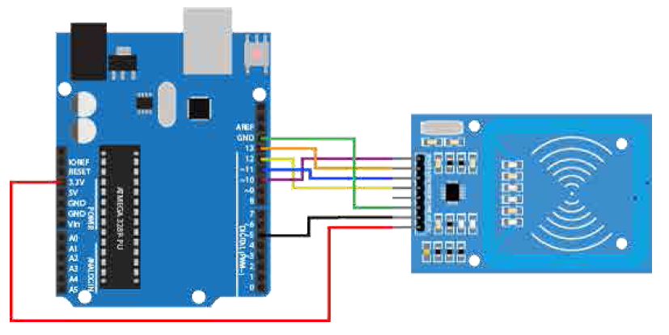
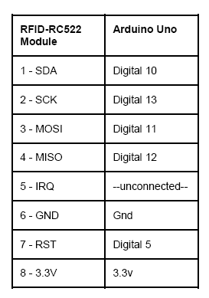

Slide 19
#include <SPI.h>
#include <MFRC522.h>
#define SS_PIN 10
#define RST_PIN 9
MFRC522 mfrc522(SS_PIN, RST_PIN); // Create MFRC522 instance.
void setup() {
Serial.begin(9600); // Initialize serial communications with the PC
SPI.begin(); // Init SPI bus
mfrc522.PCD_Init(); // Init MFRC522 card
Serial.println("Scan PICC to see UID and type...");
}

Slide 20
void loop() {
// Look for new cards
if ( ! mfrc522.PICC_IsNewCardPresent()) {
return;
}
// Select one of the cards
if ( ! mfrc522.PICC_ReadCardSerial()) {
return;
}
// Dump debug info about the card. PICC_HaltA() is automatically //called.
mfrc522.PICC_DumpToSerial(&(mfrc522.uid));
}

Slide 21
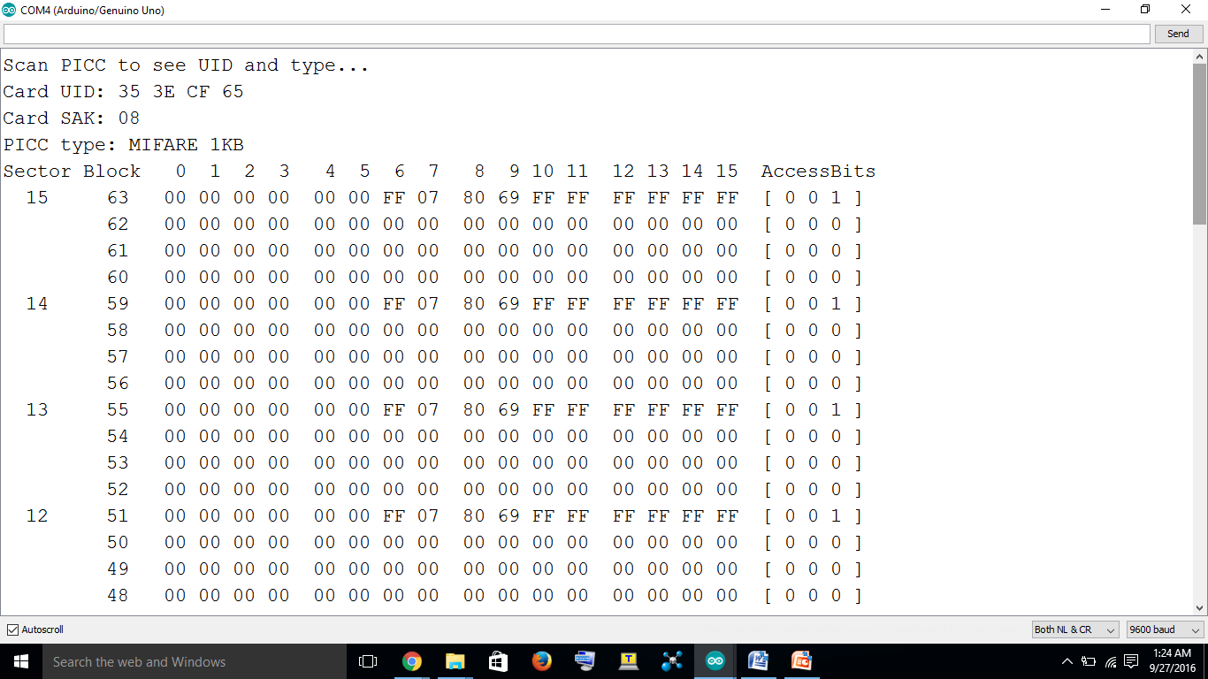

Slide 22
Current Applications
Livestock Tagging
Wild Animal Tracking
Electronic Article Surveillance (EAS)
Automated Toll Collection
Vehicle Anti-Theft

Slide 23
More Applications
Passive / Secure Entry
Airline Baggage Tracking
Postal Package Tracking
Time and Attendance

Slide 24
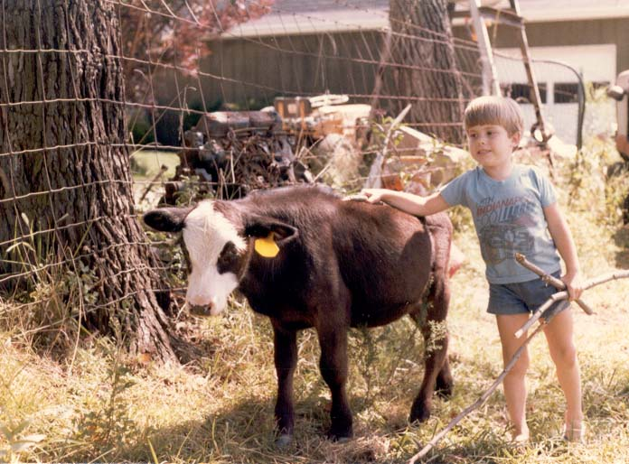
Livestock Tagging
Meet Bobby the Cow
Bobby has an old fashioned ear tag for identification.

Slide 25
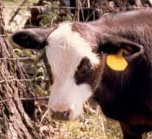
Bobby’s Part of a Herd

Slide 26
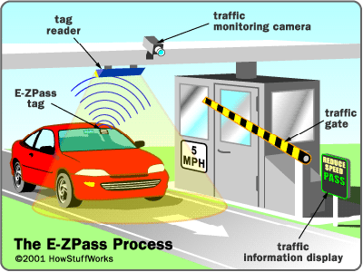
Automated Toll Collection

Slide 27
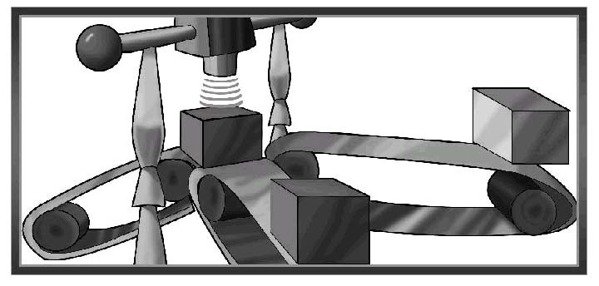
Package Tracking
Picture courtesy Texas Instruments

Slide 28
Potential Applications
Smart Grocery Store
Smart Kitchen

Slide 29
Smart Grocery Store
Every item in the store already has a bar code.
Why not use an RFID tag?
Speed up checkouts

Slide 30
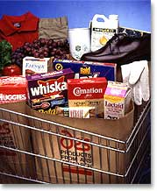
Smart Grocery Store
Several carts this full in early evening could seriously slow down the checkout process.
How much do cashiers cost?

Slide 31
Smart Grocery Store
Add an RFID tag to all items in the grocery.
As the cart leaves the store, it passes through an RFID transceiver
The cart is rung up in seconds.

Slide 32
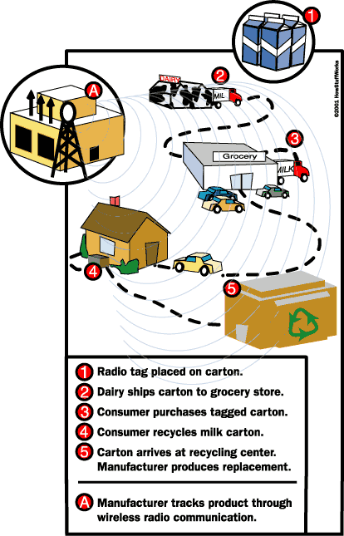
Smart Groceries Enhanced
Track products through their entire lifetime.
Diagram courtesy How Stuff Works

Slide 33
RFID’s Advantages
Passive
wireless
Store data on a tag
Can be hidden
Work in harsh environments
Low cost?

Slide 34
RFID’s Disadvantages
Lack of standards!
Short range
Cost

